Slide 1
Sampling Methods for Extremely Imbalanced Data
Chris Kuo, Ph.D.| Columbia University

Slide 2
What is imbalanced data?
Statement of the problem
Notes:
This is the question that your experiment answers

Slide 3
Imbalanced data
A dataset is imbalanced if at least one of the classes constitutes only a very small minority.
Imbalanced data prevail in banking, insurance, engineering and many other fields.
It is common in fraud detection that the imbalance is on the order of 100 to 1.

Slide 4
The Receiver operating characteristic (ROC) curve
Consider an insurance company who needs to know a claim is fraudulent or not. The company needs to predict claims that may be fraudulent and take steps to prevent.
Suppose 1% of 10,000 claims are fraudulent. If the data scientist predicts that ALL claims are not fraudulent, he gets 99% accuracy in the ROC curve. However, the data scientist totally missed the 1% true fraudulent claims.
The ROC curve does not measure well for imbalanced data.

Slide 5
The Receiver operating characteristic (ROC) curve
 | Actual positive | Actual negative
Predicted positive | TP | FP
Predicted negative | FN | TN
Name | Metric
True Positive Rate (TPR) | TP/(TP+FN)
False Positive Rate (FPR) | FP/(FP+TN)
Recall | TP/(TP+FN)
Precision | TP/(TP+FP)
FPR =1-TNR

Slide 6
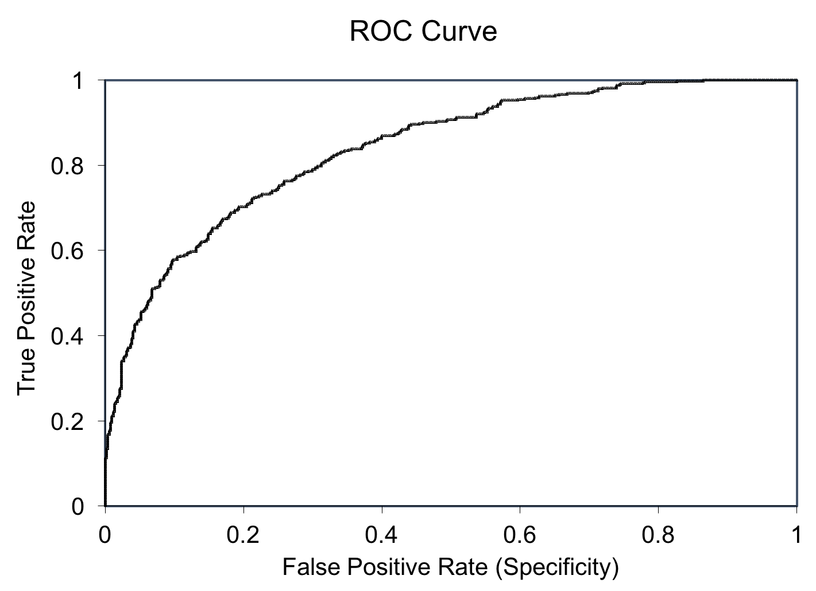
The Receiver operating characteristic (ROC) curve
TP/(TP+FN)
Sensitivity
FP/(FP+TN)
Specificity

Slide 7
Area Under the (ROC) Curve, AUC
AUC=1.0
AUC=.80
AUC=.50
Sensitivity
Specificity

Slide 8
Why can’t an ROC curve measure well?
Statement of the problem
Notes:
This is the question that your experiment answers

Slide 9
The Receiver operating characteristic (ROC) curve
Because TPR only depends on positives, ROC curves do not measure the effects of negatives.
The area under the curve (AUC) assesses overall classification performance. AUC does not place more emphasis on one class over the other, so it does not reflect the minority class well.
TP/(TP+FN)
FP/(FP+TN)

Slide 10
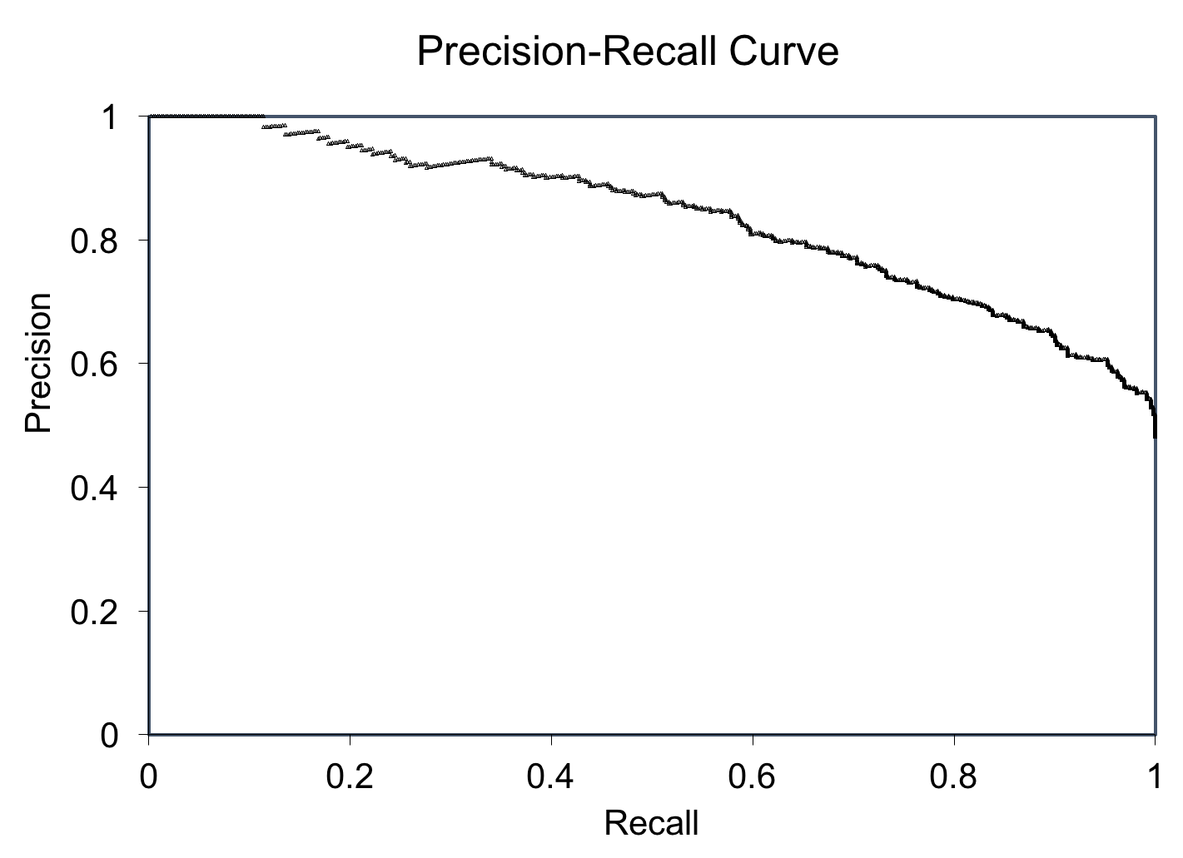
Should use the Precision-Recall curve
The Precision is directly influenced by class imbalance so the Precision-recall curves are better to highlight differences between models for highly imbalanced data sets.
By Davis and Goadrish in a well-cited paper.
TP/(TP+FP)
TP/(TP+FN)

